Slide 1

The Selfless Selfie: How Teens Negotiate the Privacy and Publicity of Photos on Social Media
Valerie Steeves, University of Ottawa, Canada

Slide 2
Research Sample
18 participants (4 boys, 14 girls) aged 13-16
Self-identified as Greek-Canadian (1), Lebanese Canadian (1), East-Asian Canadian (1), Pakistani Canadian (1), Ethiopian Canadian (1), German Canadian (1), Canadian (6)

Slide 3
Photo Diaries and Qualitative Interviews
Collected up to 3 photos a day for 7 days over 14 day period (including 2 weekend days and 5 school days)
  Photos I am comfortable sharing with lots of people
  Photos I am comfortable sharing with a few people
  Photos I am not comfortable sharing with anyone
60-90 minute interview

Slide 4
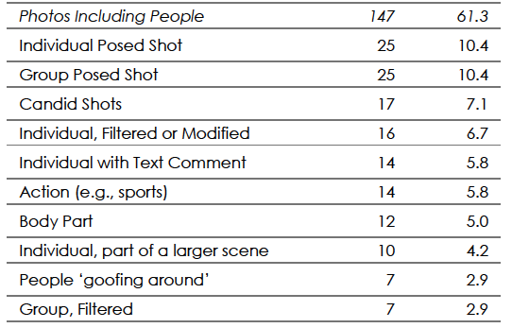
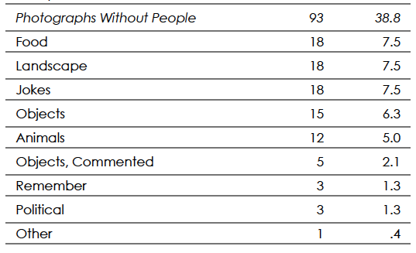
Types of Photos

Slide 5
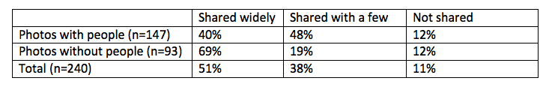
Sharing of Photos

Slide 6
Privacy Decision-Making
  Framed by concerns about avoiding negativity and obtaining certainty in performative spaces
    Negativity bias
    Dread effect
    Certainty effect
  As defined by expectations of a notional “audience” of followers

Slide 7
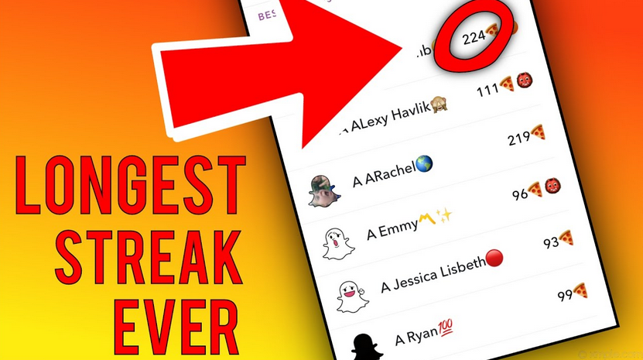
https://www.youtube.com/watch?v=vhpGQpF-71c

Slide 8
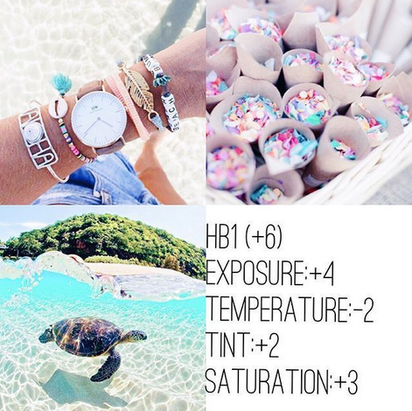
https://www.pinterest.com/explore/instagram-feed-themes/

Slide 9
“Um, some of them like, for example, in like the more pictures like scenery, it’s be like, like nice or like cool, like artsy, um or like pictures like that one.”

Slide 10
“Yeah, like even though—like, anyone can access it like I don’t know, I just kind of I guess like it’s kind of my interest and like interest of, like, certain people whereas on my personal page it’s kind of like I guess you could say appealing to everyone, whereas the other one might not be like appealing or interesting to everyone.”

Slide 11
  “interesting”
  “not random”
  “post-worthy”
  “beautiful”

Slide 12
“VSCO is more artsy for me, like, I know I post my cooler pictures over there. I thought this was a really cool picture, and I thought maybe a lot of people would like it and like to see it, because a lot of people are fans of Harry Potter, obviously …”

Slide 13
No Faces
“Like, if it’s just like, ah, like, I don’t know—like, a cat or like a TV screen, then I could share it with everyone. … But if it’s like [my friend’s face] I won’t share it with anyone. I’ll only share it with like people that like know them or something.”

Slide 14
No Faces
“Because people will judge you, I think. And like I don’t know. You just—cuz 800 people would see that ugly photo of you and that would—they would probably judge you and stuff like that I think. Yeah.”

Slide 15
“Creepy” Public – Near and Far
“[I deleted my Facebook because] I don’t want to have connections with people in my school because I don’t really like them.”
“Like on the other side of the world and I have no idea who they are and they have no idea who I am. They shouldn’t be looking at my pictures.”

Slide 16
Safe Private – Friends
“Oh yeah, yeah, yeah so I sent it in a, in—like we have a group chat, like, just us and I just sent it in there like kind of just saying like ‘it’s a cool picture’ or whatever. Like maybe like we’ll post it or something sometime, but I just didn’t really want to post it then. Like, it’s a good picture, there’s nothing wrong with it. I don’t know. I just didn’t really feel like posting at that time.”

Slide 17
Safest Private – My Phone
“Well, with family, it’s kind of like, family is great and everything, but family isn’t something that you throw outside there for the whole world to see. It’s kind of something that stays personally to you. … when I have family photos I feel scared of posting them because I care about my family and I don’t want them to feel envied by other people. So, yeah.”
“Cuz I don’t want—cuz I kinda—I really like my family. I really like my brother. I don’t want anyone making fun of my brother.”

Slide 18
Two Exceptions
Birthday Pics and Tags to Show Affection
  “My friend, this summer he went to Italy. Like, he posted like three photos of the whole summer and I was tagged in all of them and like I wasn’t there... But I guess he’s like thinking of his close friends. Like, when he’s there like how he misses them when he’s in Italy.”
Fansites

Slide 19
Certainty

Slide 20
Whither data protection?
Privacy as non-disclosure vs. privacy as boundary negotiation/audience control
Big data and consent
Control of private information vs. private online spaces
Challenging commodification and the need for non-commercial public online spaces

Slide 21
vsteeves@uottawa.ca equalityproject.ca

